Slide 1
Task 3:- Design an interactive dashboard for business stakeholders.

Slide 2
Task Overview
This project showcases a Business Stakeholder Dashboard built in Power BI.
It provides stakeholders with insights into revenue performance across regions, stores, products, and sales representatives.
The dashboard helps identify top-performing areas, track KPIs, and support data-driven decision-making.

Slide 3
Key Metrics (KPIs)
Total Revenue: 127.41M
Average Revenue per Transaction: 39.04K
Total Countries Covered: 3264
Total Transactions: 3264

Slide 4
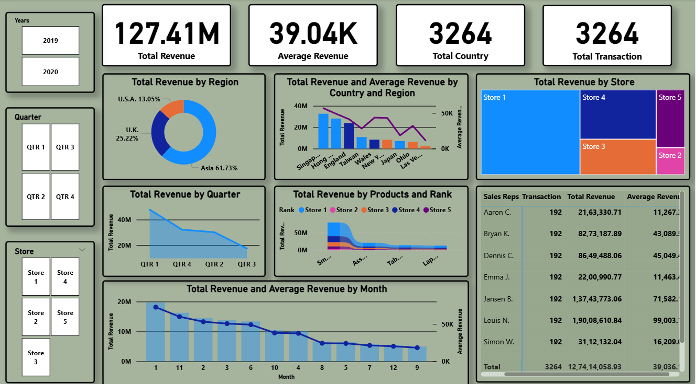
Dashboard

Slide 5
Revenue Analysis
By Region:
Asia: 61.73%
U.K.: 25.22%
U.S.A.: 13.05%
By Store:
Store 1 leads; Store 2 & 5 underperform.
By Quarter:
Peak in Q1, decline in later quarters.
By Products:
Smartphones & Accessories dominate revenue.

Slide 6
Sales Representative Performance
Louis N.: Top performer (190M revenue, 99K avg.)
Jansen B.: Strong contributor (137M revenue)
Others show varied performance.

Slide 7
Business Value Delivered
Identify high-performing regions, stores, and products.
Monitor sales rep contributions.
Detect seasonal and quarterly revenue trends.
Enable data-driven decisions and strategy optimization.

Slide 8
Tools & Technology
Power BI for interactive dashboard design
Power Query for data cleaning & transformation
DAX for KPI calculations
Visuals: Donut, Tree Map, Line, Bar, KPI Cards, Tables

Slide 9
Final Insights
Asia dominates sales with 61.73% share.
Store 1 is the top performer; Store 2 & 5 lag behind.
Revenue peaks in Q1; seasonal trends observed.
Louis N. is the highest-performing sales rep.
The dashboard enables clear, data-driven insights for business growth.

Slide 10
THAKYOU

